Slide 1

TOPIC-Libre office Impress
COURSE: CCC
CHAPTER: 05 (Impress)
NIELIT
Presentation By : Shruti Dubey

Slide 2
Content
Introduction
Creation of Presentation
Creating a Presentation Using a Template
Creating a Blank Presentation
Inserting & Editing Text on Slides
Inserting and Deleting Slides in a Presentation
Saving a Presentation
Manipulating Slides
Inserting Table
Adding Pictures
Inserting Other Objects
Resizing and Scaling an Object

Slide 3
Content
Creating & using Master Slide
Presentation of Slides
Choosing a Set Up for Presentation
Running a Slide Show
Transition and Slide Timings
Automating a Slide Show
Providing Aesthetics to Slides & Printing
Enhancing Text Presentation
Working with Color and Line Style,
Adding Movie and Sound
Adding Headers, Footers and Notes
Printing Slides and Handouts

Slide 4
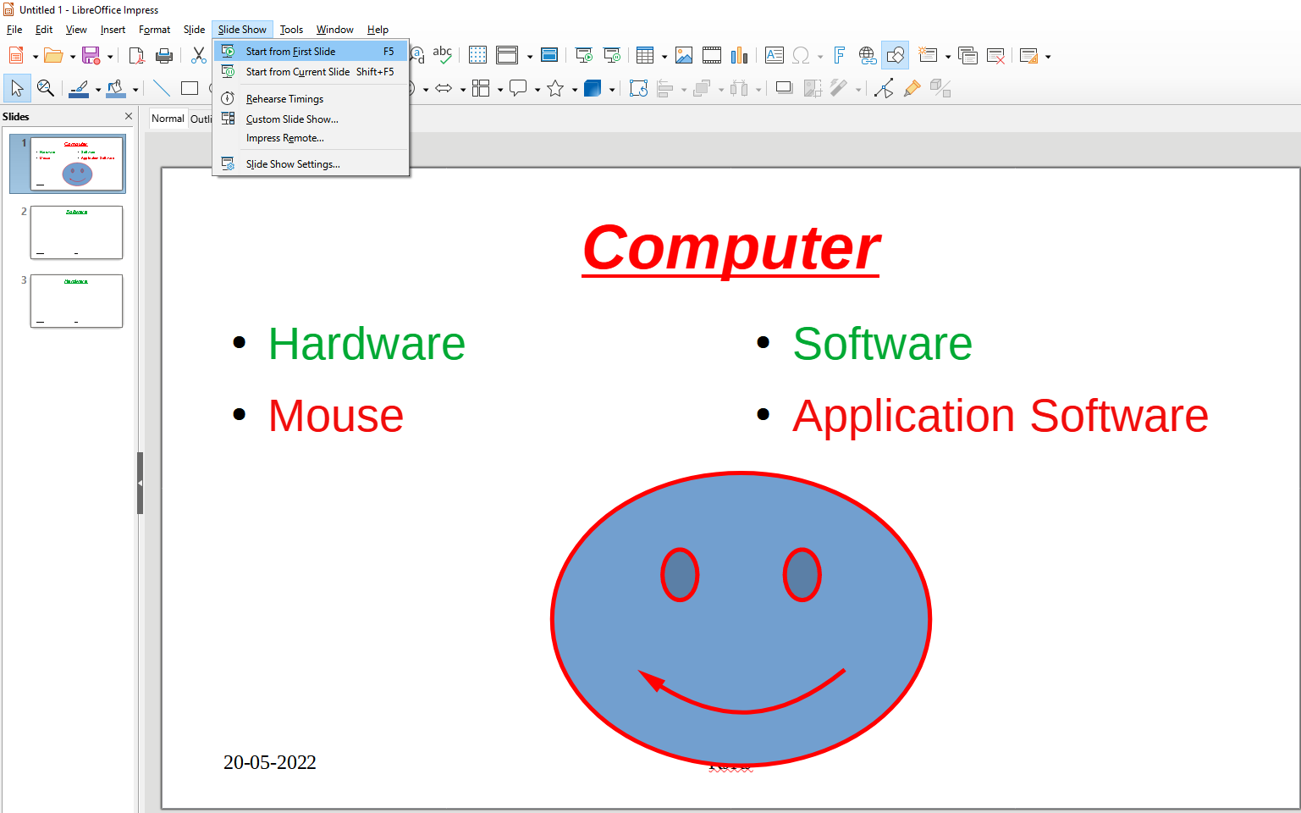
Running a Slide Show

Slide 5
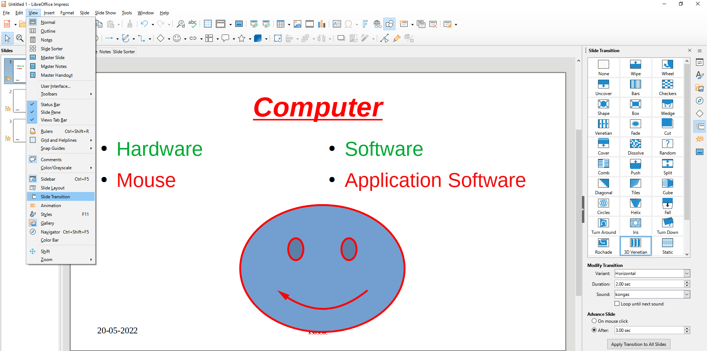
Slide Transition

Slide 6
Transition and Slide Timings Automating a Slide Show

Slide 7
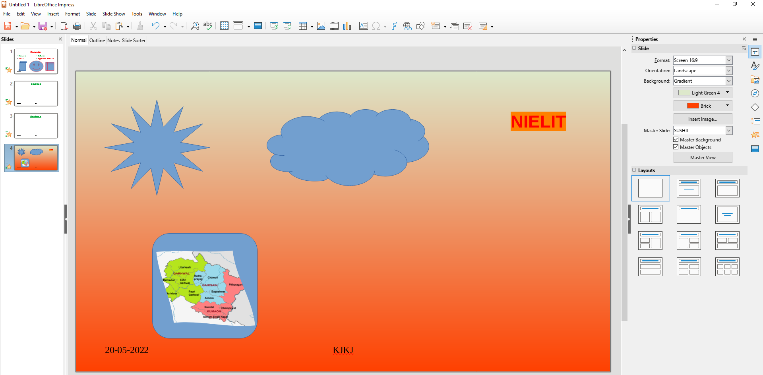
Providing Aesthetics to Slides & Printing

Slide 8
Adding Movie and Sound

Slide 9
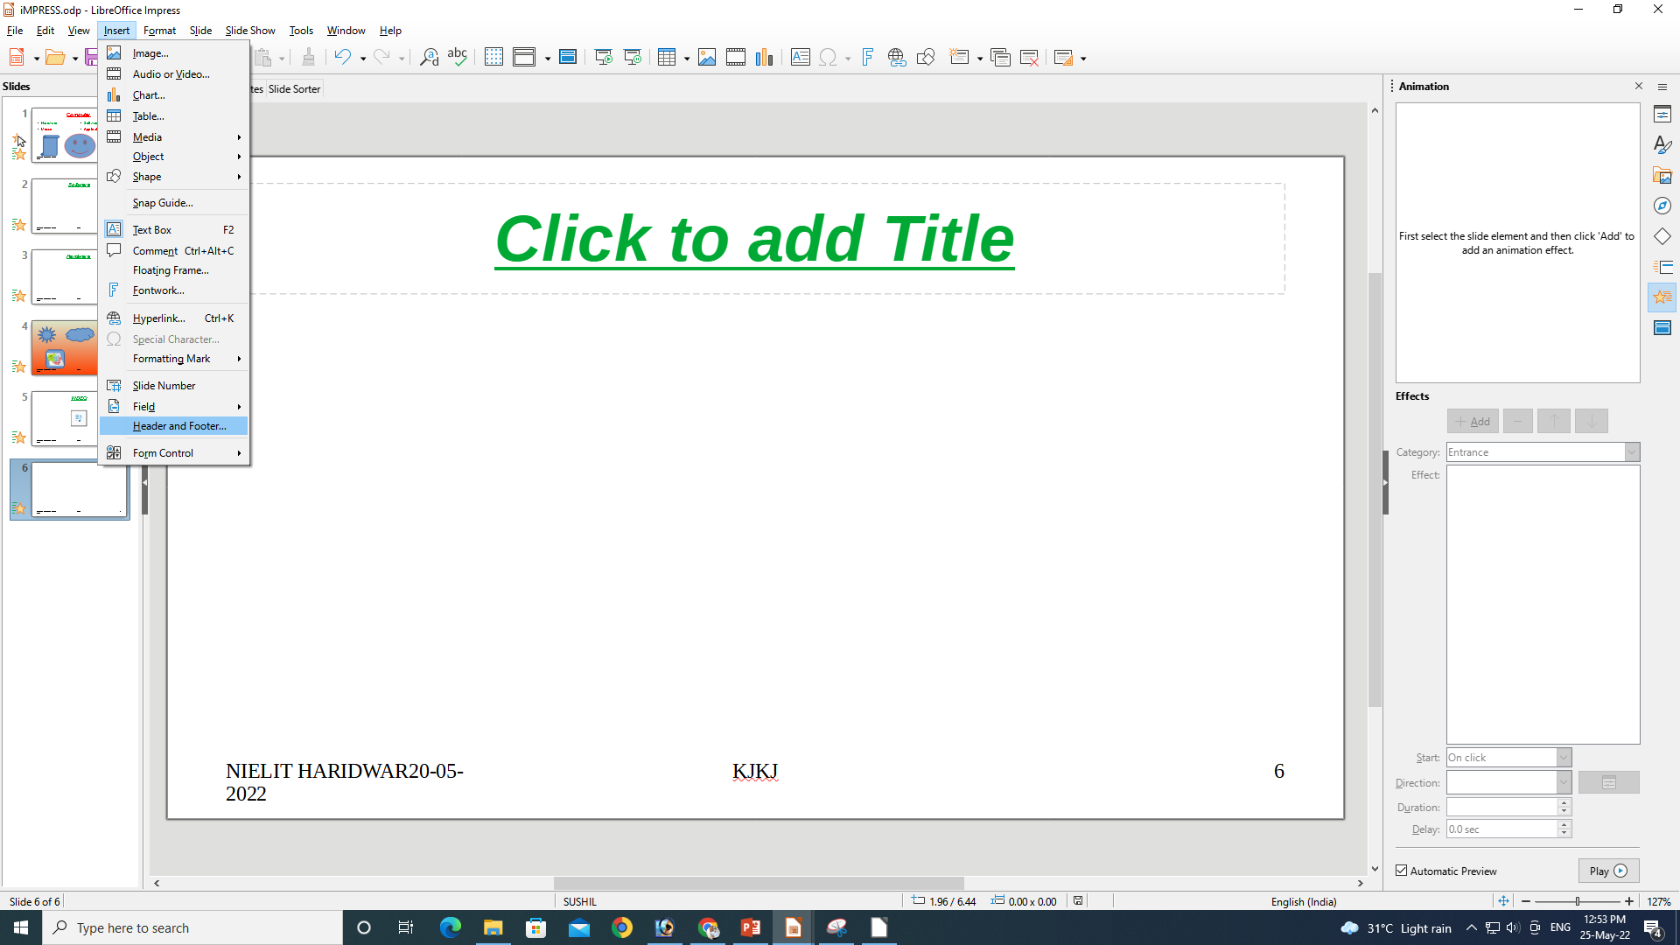
Adding Headers, Footers and Notes

Slide 10
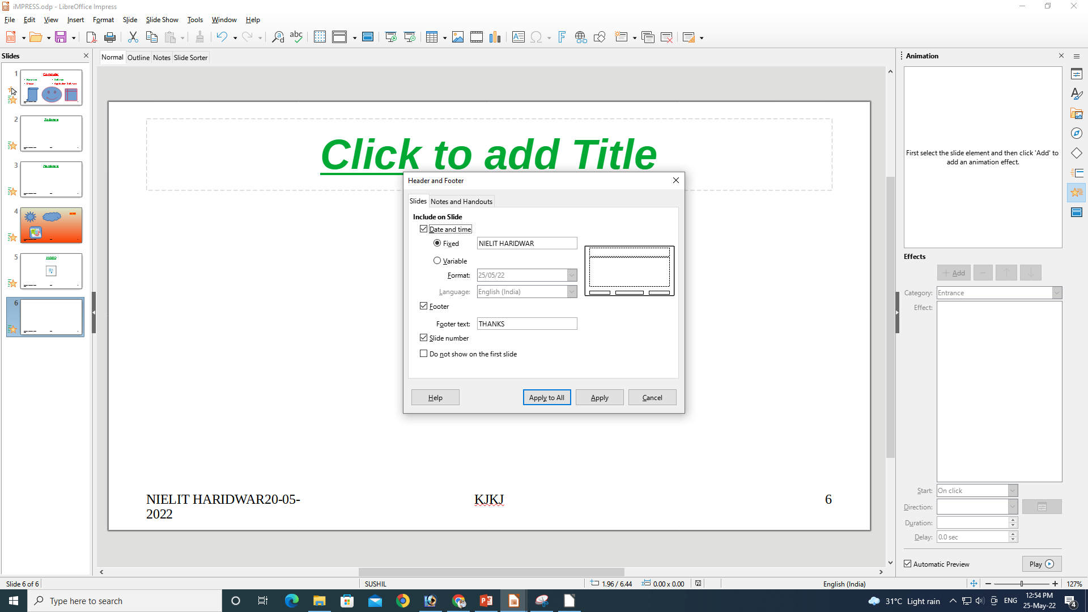
Adding Headers, Footers and Notes

Slide 11
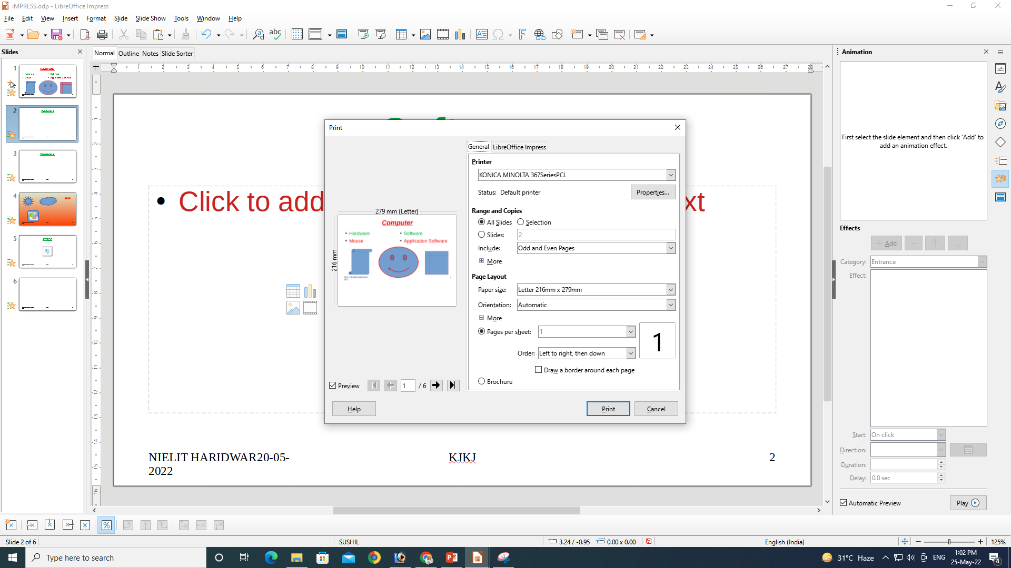
Printing Slides and Handouts

Slide 12
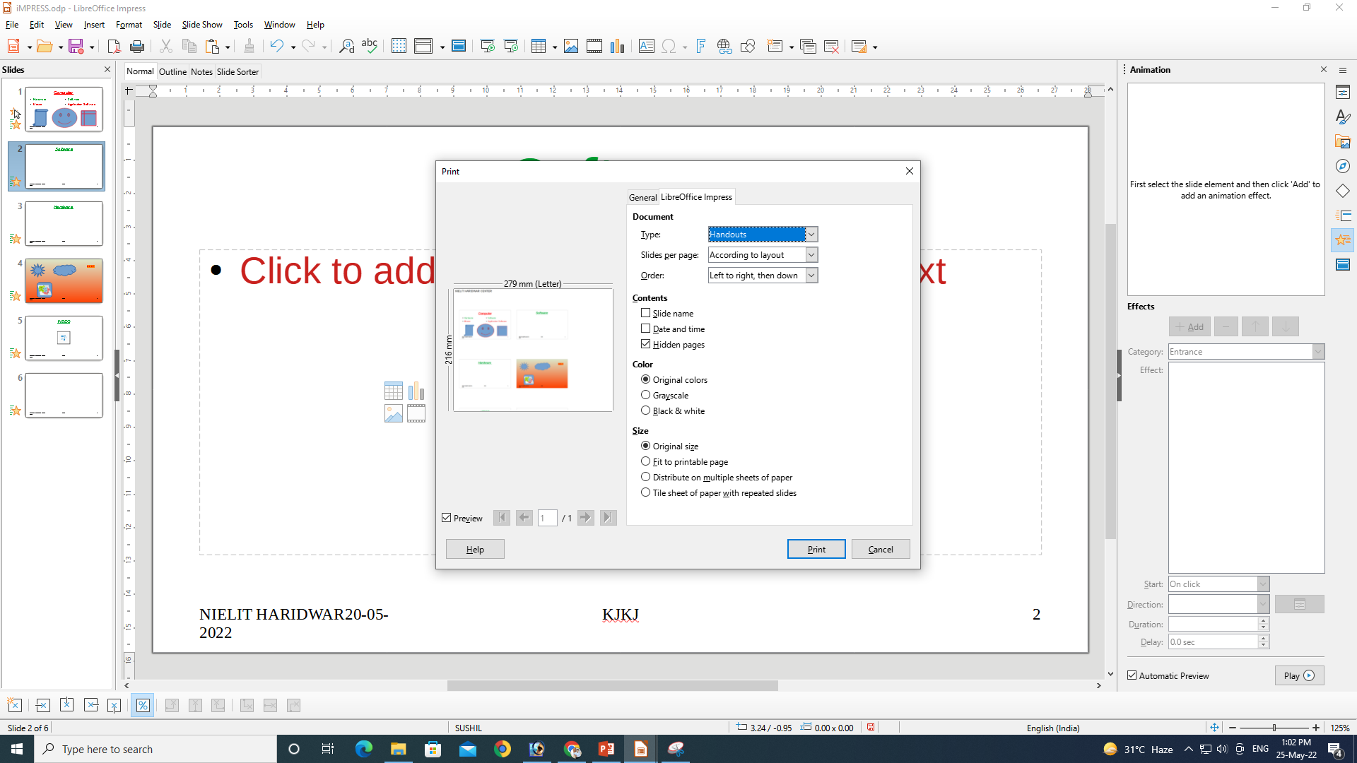
Printing Slides and Handouts

Slide 13
Thank You
NIELIT
Presentation By : Shruti Dubey

